Slide 1
Mobile Robot Exploration
Bill Hunt, Annie Hernandez & Trevor Rocks
Notes:
All

Slide 2
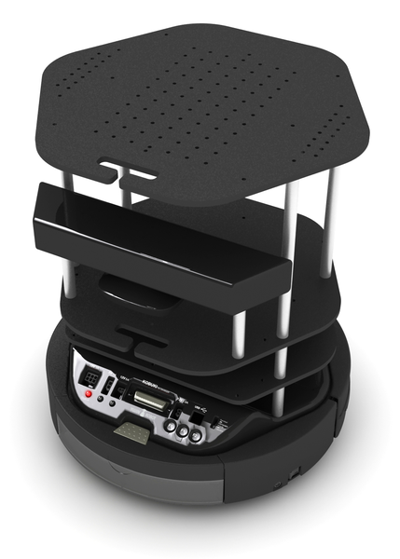
Goal & Challenges
Goal: Map an unknown closed environment autonomously, within twenty minutes.
Challenges:
SLAM and A* (handled by GMapping)
Frontier detection
Frontier grouping (blobbing)
Goal selection
Completion detection
Fault detection and recovery
http://cdn.shopify.com/s/files/1/0084/1842/products/Back_grande.png?v=1351283525
Notes:
Trevor Rocks

Slide 3
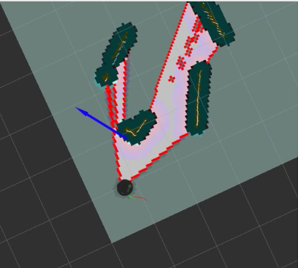
Frontier Detection and Blobbing
Expand obstacles in map to account for robot dimensions.
Wavefront out from robot to determine frontiers (boundaries of known map).
Group frontiers into “blobs” based on contiguity.
Notes:
Trevor ROcks

Slide 4
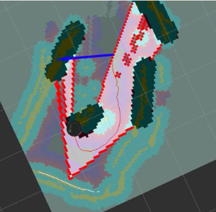
Goal Selection
Here, the robot has found a usable goal: the centroid of a frontier.
GMapping’s path planning and navigation are used to navigate to the waypoint.
Our node is subscribed to move_base/result, so we are notified when GMapping reaches a goal or experiences a failure.
Notes:
BIll Hunt

Slide 5
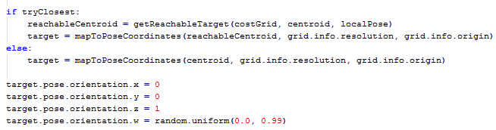
Fault Detection and Recovery
Sometimes GMapping cannot reach a normally-generated goal.
When enough failures occur, our node reanalyzes the occupancy grid using a less zealous obstacle expansion algorithm.
Instead of choosing the centroid of the largest frontier, we find a reachable point in the global costmap that is nearby the ideal centroid target.
We target a random orientation at each goal location, to promote stochastic map growth.
Notes:
Annie Hdz

Slide 6
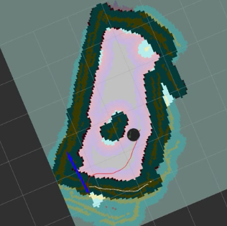

Final Map
Completed outer perimeter (very small residual frontiers are allowed).
Entire interior area explored
Obstacle within interior is well defined and topology of space is accurate.
We don’t terminate in the fault condition; the robot must recover and then check for termination criteria.
When exploration is complete, the user sees a bash prompt:
Notes:
Annie Hdz

Slide 7
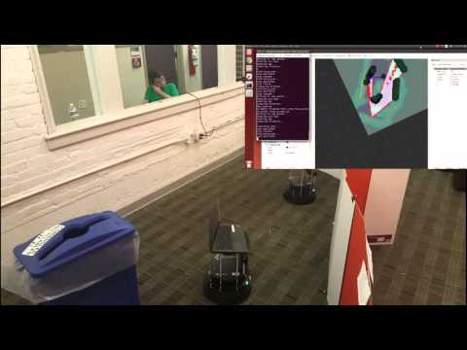
Video of operation
We are happy to answer any questions that you may have.
Thank you for a fantastic and interesting course!
Link to video: https://www.youtube.com/watch?v=V5FJzfqFjpA
Notes:
All

